Slide 1
l-4 UNSUPERVISED LEARNING
(24.12.2020)

Slide 2
Unsupervised vs supervised learning
In a supervised learning model, the algorithm learns on a labeled dataset, providing an answer key that the algorithm can use to evaluate its accuracy on training data.
An unsupervised model, in contrast, provides unlabeled data that the algorithm tries to make sense of by extracting features and patterns on its own.

Slide 3
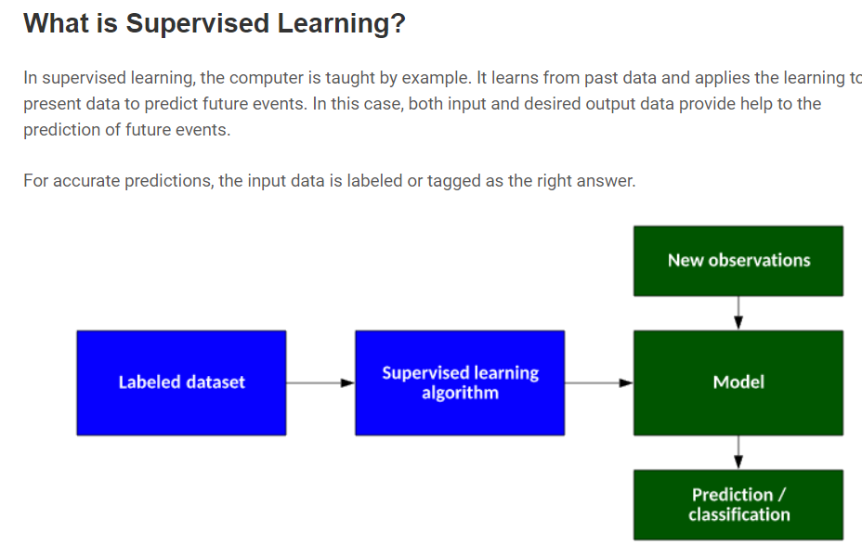

Slide 4
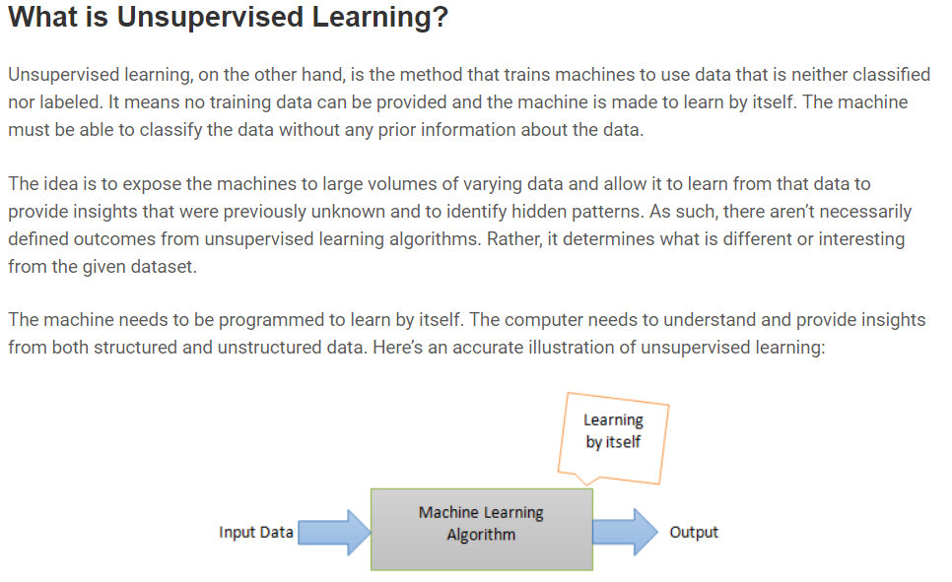

Slide 5
Why Unsupervised Learning?
Unsupervised machine learning finds all kind of unknown patterns in data.
Unsupervised methods help you to find features which can be useful for categorization.
It is taken place in real time, so all the input data to be analyzed and labeled in the presence of learners.
It is easier to get unlabeled data from a computer than labeled data, which needs manual intervention.

Slide 6
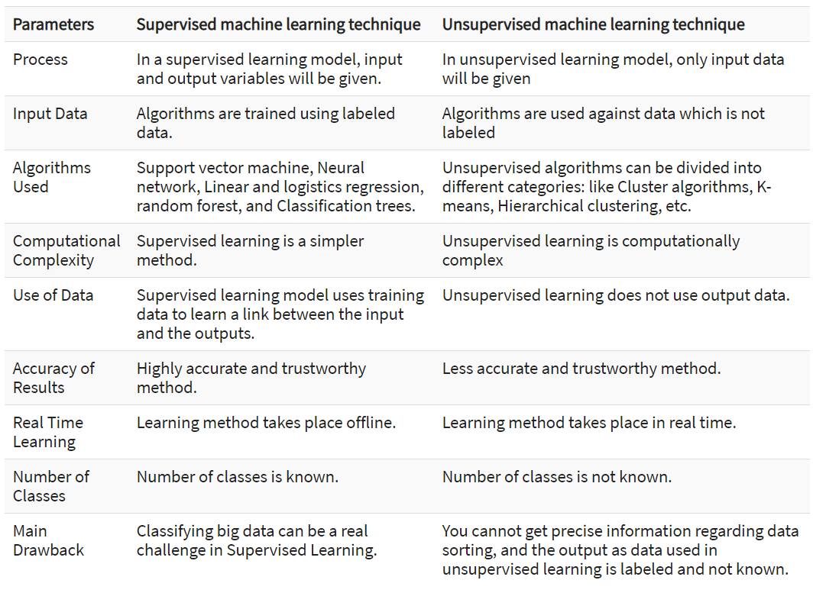

Slide 7
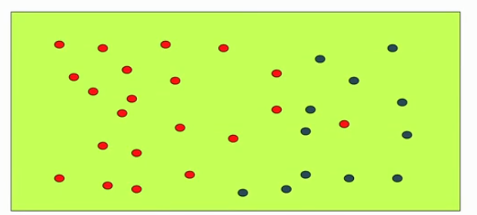
Labelled training data

Slide 8
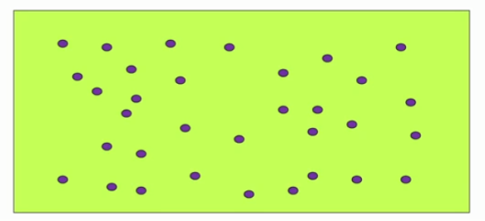
Unlabelled data

Slide 9
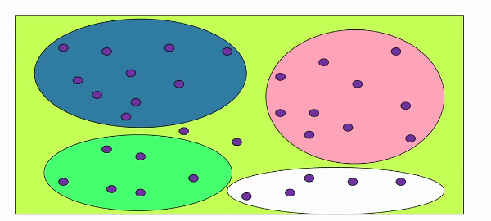
Possible clusters
Points not fall in any of the clusters, outliers

Slide 10
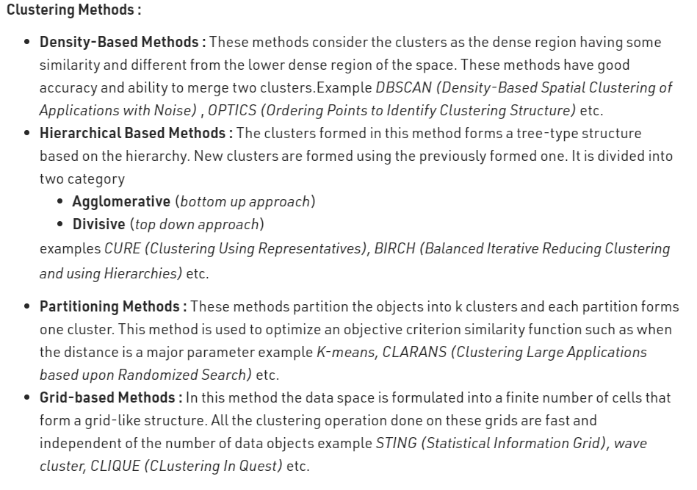
Clustering methods

Slide 11
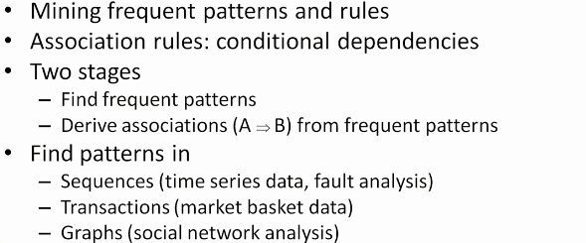
Association rule mining –finding frequent patterns

Slide 12
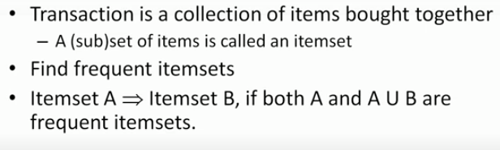
Mining transactions

Slide 13
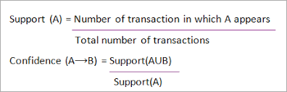
Support and confidence

Slide 14
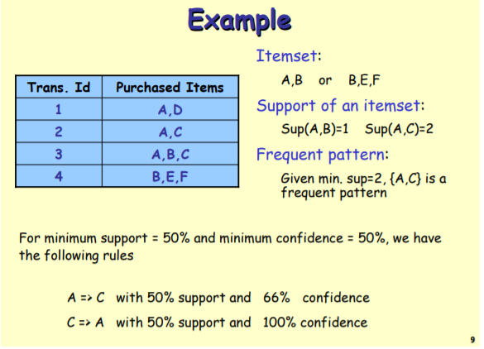

Slide 15

Applications

